Slide 1
Epilepsy
Seizure detector

Slide 2
Why are we building it?
Mortality
2 to 3 times
2. Avoidable
39%
3. Unknown triggers

Slide 3
How does it work?

Slide 4
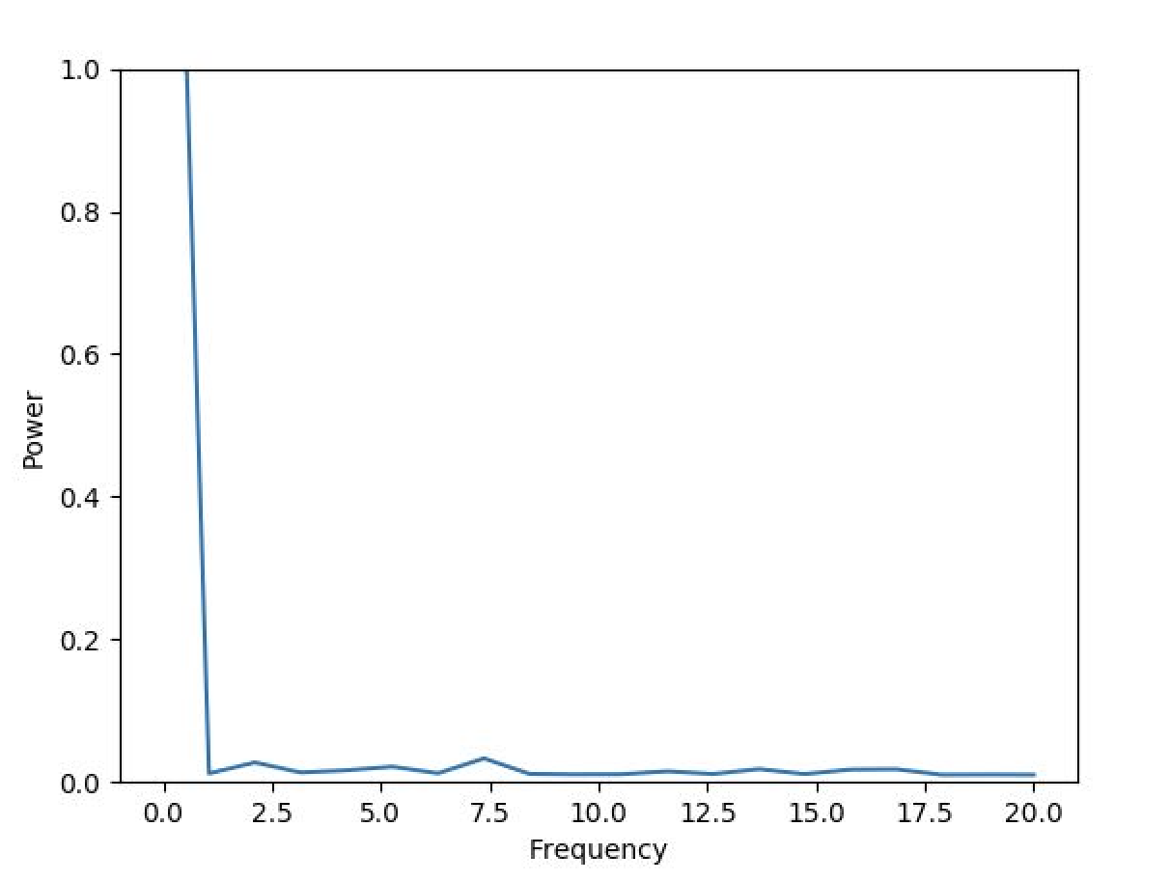
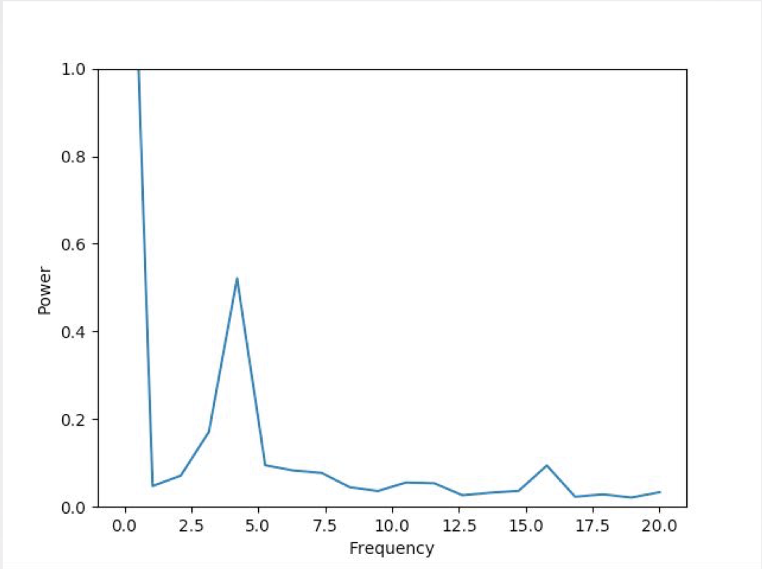
How to difine a epilepsy?

Slide 5
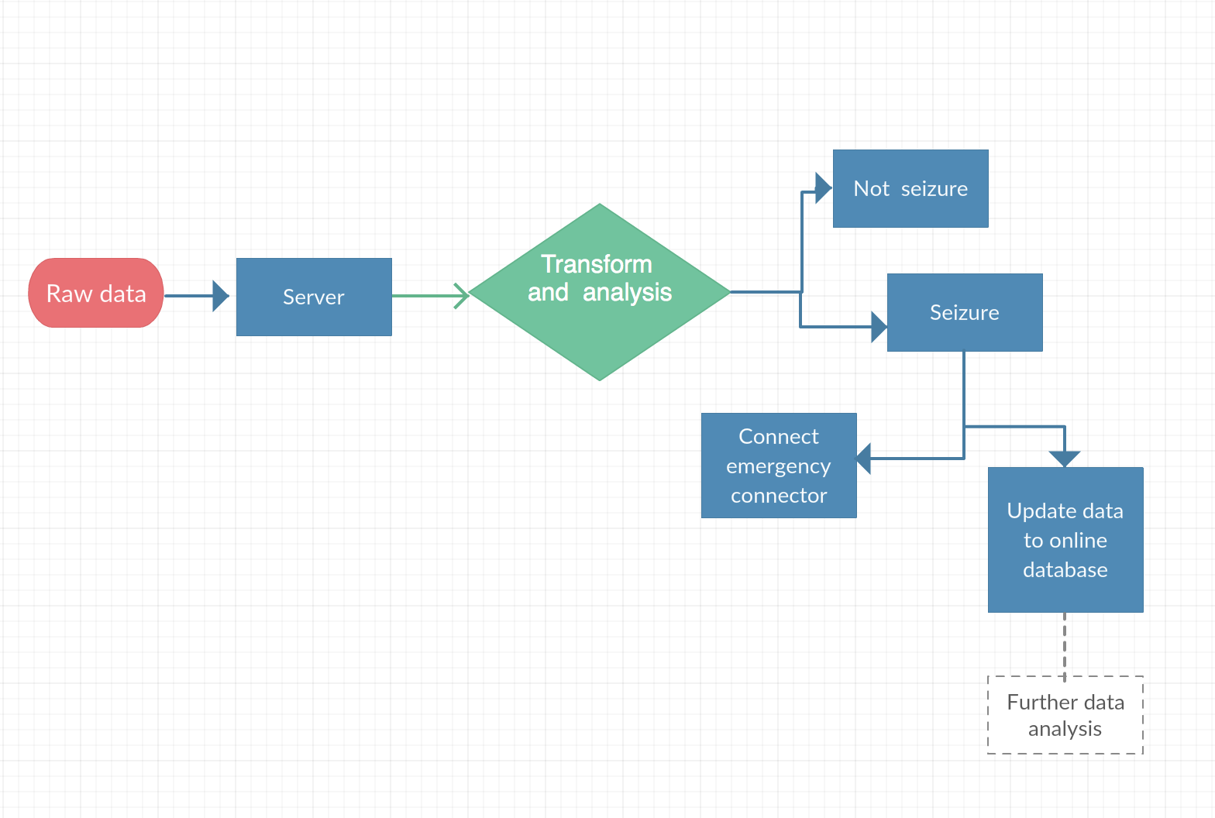
Flow chart

Slide 6
Further development

Slide 7
Data Visualisation
App
(With higher broadband) more data collected for analysis
Protection+
Machine learning to achieve better determination

